Slide 1
Adham Ashraf Saeed
Assignment 4 (Final Project)

Slide 2
Project Objectives
Clean and prepare raw data
Use Excel formulas effectively
Perform exploratory data analysis
Build Pivot Tables & dashboards
Generate business insights

Slide 3
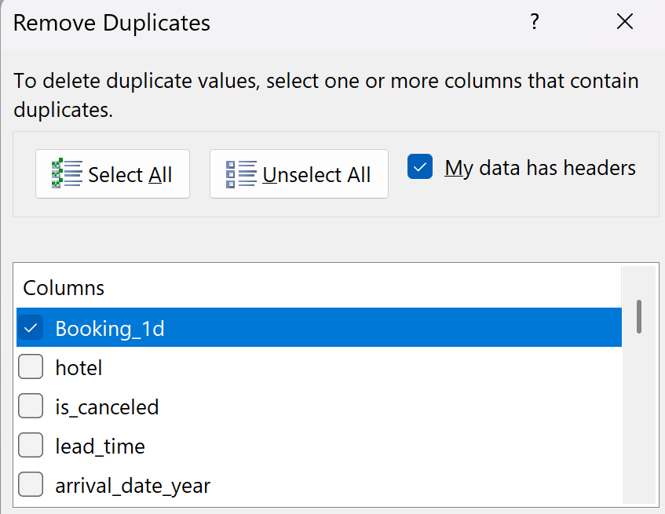
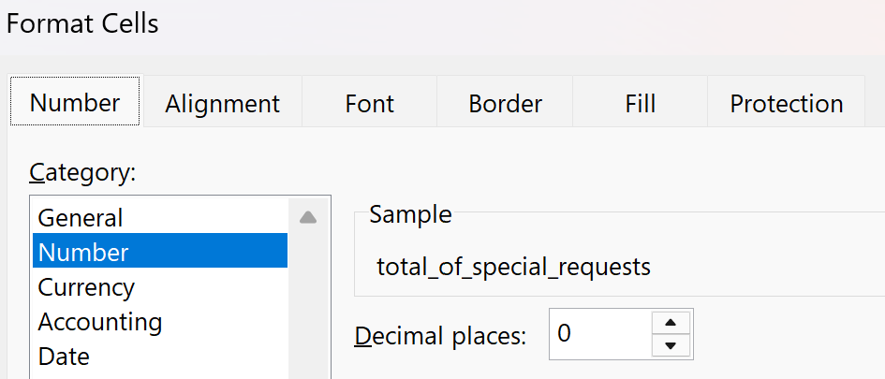
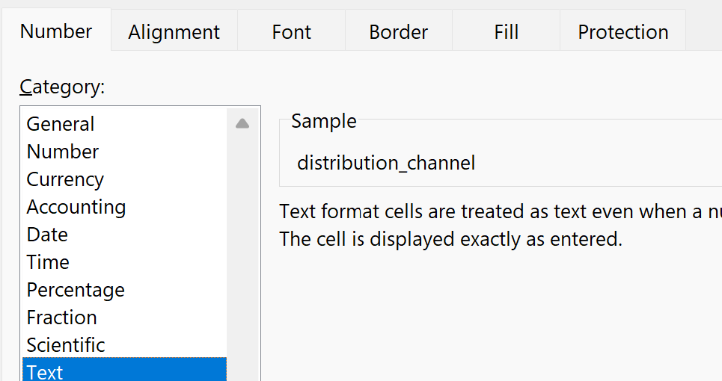
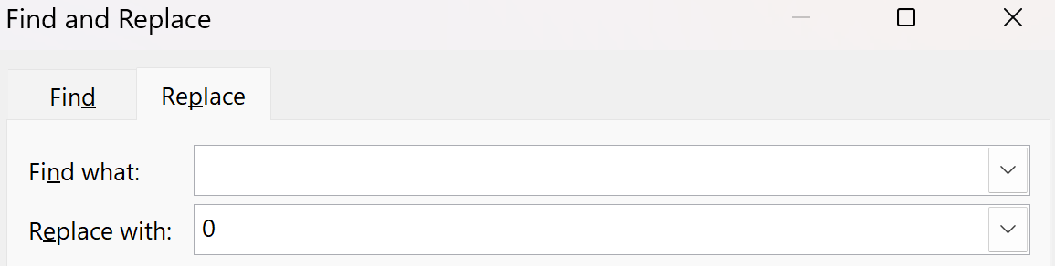
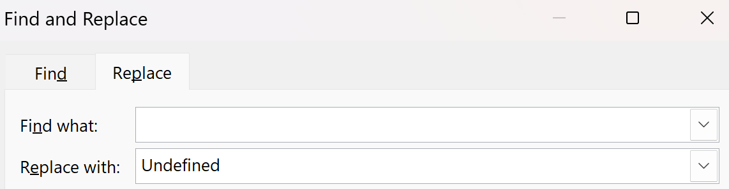
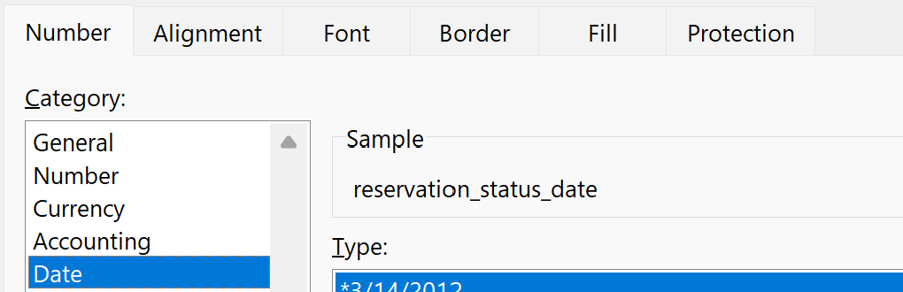

Task 1
Phase 1: Data Cleaning & Preparation
Start with data Importing and Date Exploration and understanding each column and its values meaan
Remove duplicates (if any) In Primary Key(Booking_ID)
Handle missing values
Standardize text fields
Identify Arrival Date Issue

Slide 4




Task 2
Phase 2: Creating useful (Calculated Columns)
Total Stay Nights
Guest Type ("Single", "Couple", "Family")
Arrival date (Month/ Day/ Year)
Payment Risk("High Risk", "Low Risk") Based on Deposit Status
Total Guests

Slide 5





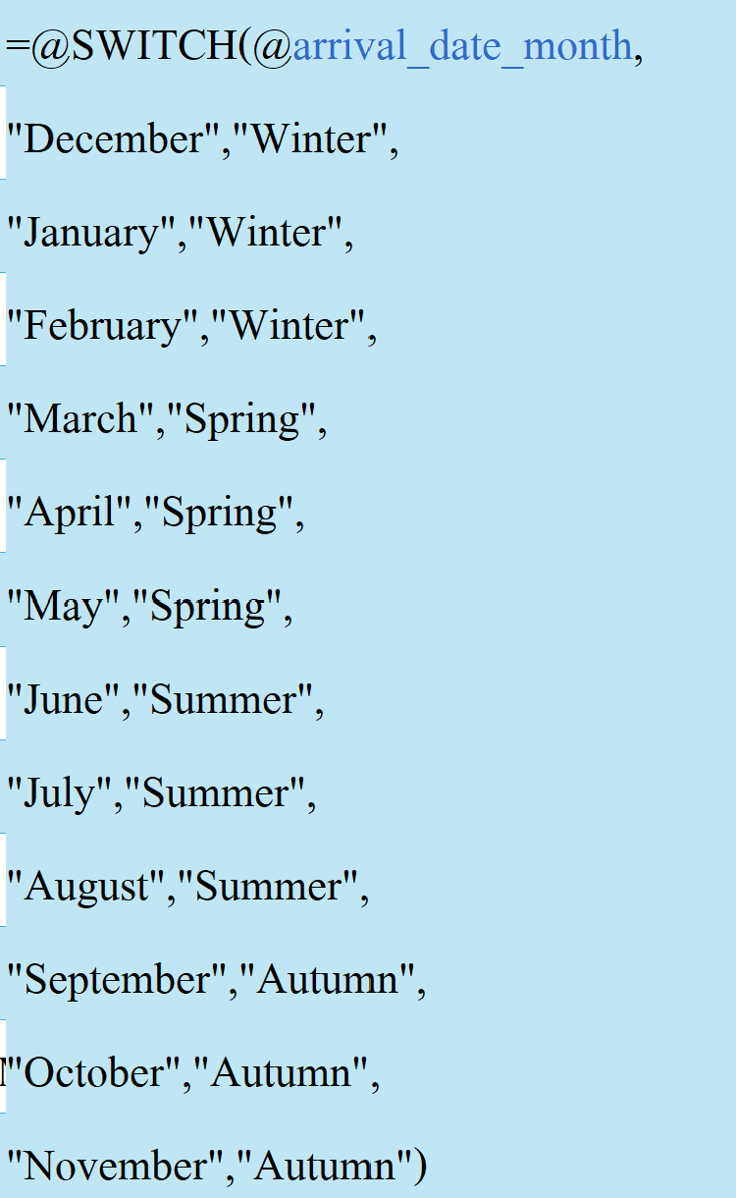

Task 2
Phase 2: Creating useful (Calculated Columns)
Revenue per Booking
Booking Status ( Cancelled/ Not Cancelled)
Lead Time Category (Long: Higher than 90 days , Medium, Short: less than 30)
Feel Free to create more calculated columns to enhance your Analysis

Slide 6
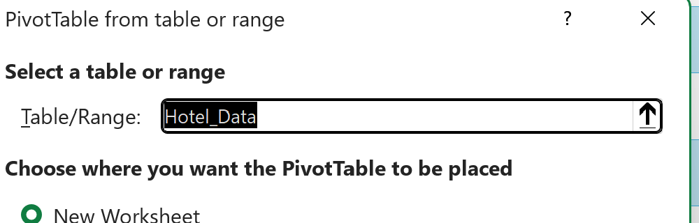
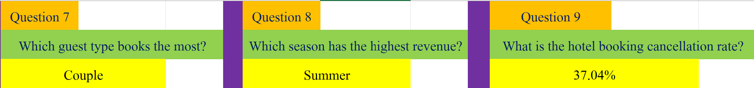
Task 3
Phase 3: PivotTables & Insights
Ask Strong business Questions and answer it by Pivot Tables

Slide 7
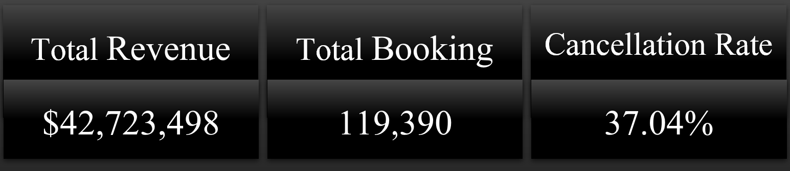
Task 4
Phase 4: Data Visualization
Create charts to Visualize each
Dashboard Creation: Build an interactive dashboard including:
KPIs:
Total Bookings
Total Revenue
Cancellation Rate

Slide 8
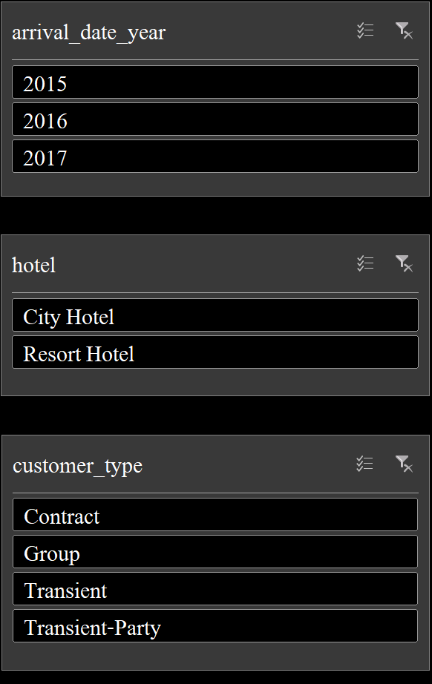
Task 4
Phase 4: Data Visualization
Create charts to Visualize each
Dashboard Creation: Build an interactive dashboard including:
Filters (Slicers):
Hotel Type
Year
Customer Type
Charts & PivotTables

Slide 9
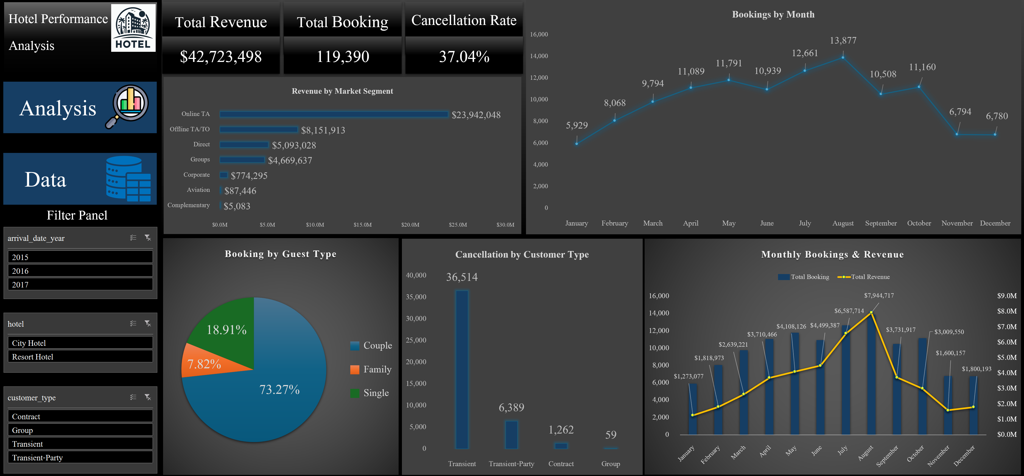
Dashboard

